Slide 1

Title:
Real-World experience of low dose PARP inhibitors in BRCA mutated or HRD positive Ovarian cancer - A Prospective single center study from Eastern India
Name: Y. Susheel Kumar
Designation: Senior Resident
Department: Medical Oncology
Institution Name: IMS AND SUM Hospital
Location: Bhubaneswar

Slide 2
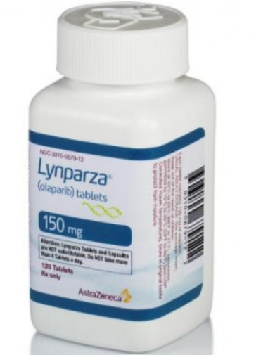
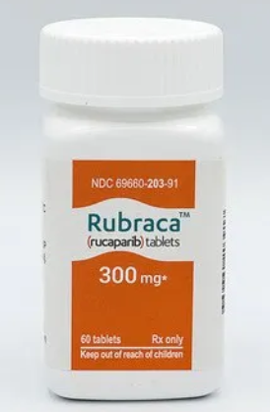
Background
Maintenance PARPi following a platinum-based response in locally advanced HGSOC has demonstrated a significant PFS and OS benefit¹
The per capita income Odisha - ₹1,61,437
India's per capita income of - ₹1,84,205
Olaparib
Rucaparib
₹28.8 lakhs/annum
₹12 lakhs/annum
Veneziani, A.C., Gonzalez-Ochoa, E., Alqaisi, H. et al. Heterogeneity and treatment landscape of ovarian carcinoma. Nat Rev Clin Oncol 20, 820–842 (2023). https://doi.org/10.1038/s41571-023-00819-1

Slide 3
Despite insurance/state sponsored scheme/out of pocket expenditure, they are largely unaffordable in LMIC like India
In this context, low-dose PARP inhibitors (PARPi) emerge as an attractive alternative, offering financial feasibility besides improved tolerance

Slide 4
Methods
This is a hospital-based, prospective, observational, single-center study, conducted between May 2019 to May 2023
n= 128
1⁰ – PFS
LA HGOC
III/IV
Consented
Demographic factors
PFS, TOXICITY
gBRCA +
gBRCA –

Slide 5
Patients Characteristic | N=128 (%)
Median age | 51.5 (25-79)
Family history | 14 (10.9)
Stage I II III IV | 2 (1.5) 4 (3.3) 79 (61.7) 43 (33.5)
Histology Serous Endometroid Mucinous Clear cell | 118 (92.1) 7 (5.5) 2 (1.6) 1 (0.8)
Patients Characteristic | N=128 (%)
Median TAT (days) gBRCA HRD | 20 25
Mutation testing gBRCA tBRCA HRD gBRCA + tBRCA gBRCA + HRD tBRCA + HRD gBRCA + tBRCA + | 102 (79.7) 8 (6.3) 1 (0.8) 5 (3.9) 8 (6.2) 3 (2.3) 1 (0.8)

Slide 6
g&tBRCA+ (2)
tBRCA+ (1)
VUS (2)
HRD - (4)
 | N=28
BRCA1 | 22
BRCA2 | 5
Non BRCA HRD+ | 2
gBRCA+ - (21)
16.4%
76.6%
Negative
(98)
All of BRCA/HRD+ patients were of HGS/Endometroid

Slide 7
BCRA/HRD+ - 128
BRCA/HRD+ (N=28)
13 pt not received
PARPi Intake - 15

Slide 8
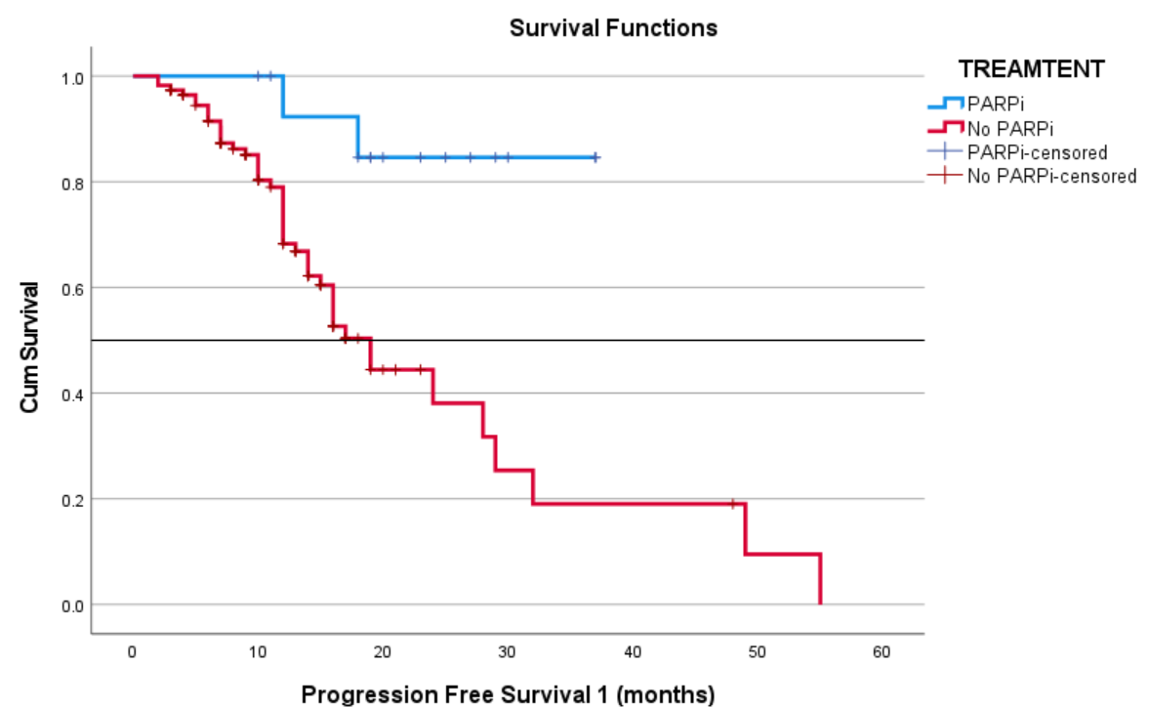
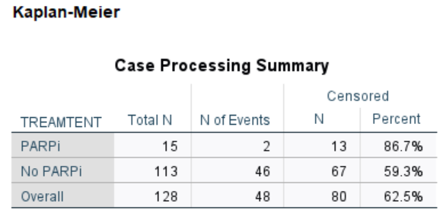
PFS outcomes – PARPi vs No PARPi
N=15
 | PARPi (n=15) | No PARPi (n=113)
Median PFS | NR | 19
P value | 0.003
N=113

Slide 9
Comparative Analysis
PFS outcomes – PARPi vs No PARPi
 | OUR STUDY | SOLO1² | ATHENA MONO³
PFS12 PARPi group | 86.6% | 89% | 76.5%
PFS12 No PARPi group | 59.3% | 51% | 52%
2. Moore K, Colombo N, Scambia G, Kim BG, Oaknin A, Friedlander M, Lisyanskaya A, Floquet A, Leary A, Sonke GS, Gourley C. Maintenance olaparib in patients with newly diagnosed advanced ovarian cancer. New England Journal of Medicine. 2018 Dec 27;379(26):2495-505.
3. Monk BJ, Parkinson C, Lim MC, O'malley DM, Oaknin A, Wilson MK, Coleman RL, Lorusso D, Bessette P, Ghamande S, Christopoulou A. A randomized, phase III trial to evaluate rucaparib monotherapy as maintenance treatment in patients with newly diagnosed ovarian cancer (ATHENA–MONO/GOG-3020/ENGOT-ov45). Journal of Clinical Oncology. 2022 Dec 1;40(34):3952-64.

Slide 10
Adverse Events
Pt | Anaemia | Neutropenia | Thrombocytopenia | Fatigue | Nausea | Diarrhoea | Constipation | Anorexia
1 | G2 | - | G1 | G1 | - | - | - | -
2 | - | - | - | - | - | - | - | -
3 | G3 | - | - | G2 | - | - | - | G1
4 | - | - | - | - | - | - | - | -
5 | G1 | G2 | - | - | - | - | - | -
6 | G1 | - | - | G2 | - | - | - | -
7 | G2 | G1 | - | - | - | - | - | -
8 | - | - | - | - | - | - | - | -
9 | - | - | - | - | - | - | - | -
10 | G1 | - | - | G1 | - | - | - | -
11 | - | - | - | - | - | - | - | -
12 | - | - | - | - | - | - | - | -
13 | G1 | G2 | G1 | G1 | G1 | - | - | -
14 | - | - | - | - | - | - | - | -
15 | - | - | - | - | - | - | - | -
Notes:
Dose interruption - 3

Slide 11
Conclusion
Our study on low-dose PARPi in locally advanced HGSOC demonstrated comparable efficacy as standard dose with lesser toxicity.
However, the study was limited by a relatively short follow-up period and a small sample size.
To validate our findings, phase 3 randomized controlled trials are needed.

Slide 12
THANK YOU धन्यवाद

