Slide 1

Title: Developing a Framework for Capacity Building to Improve Cancer Screening Among Women in Rural Areas
Presenter’s details:
Name: Dr. Harimadhav Viswanathan
Designation: Fellow II
Department: Preventive Oncology
Institution Name: Tata Memorial Hospital
Location: Mumbai

Slide 2
Background
Building capacity to improve health is an important element of effective health promotion practice.
It increases the range of people, organisations and communities who can address a particular health problem.
Due to the existing socio-cultural factors, women show resistance to initiatives like cancer screening.
Addressing vulnerable and high-risk populations like women and rural people is important in cancer control initiatives.

Slide 3
Aim
To develop a comprehensive model for capacity-building initiatives tailored for cancer screening programs in rural areas
To assess the impact of capacity-building initiatives on the participation rates in cancer screening among rural women
Methodology
Study setting: Khopoli, Raigad District, Maharashtra
Study design: Community based screening program
Study population: Women aged between 25-65 years
Study duration : Thirty months (February 2022-September 2024)
Sampling strategy: Universal sampling to include all the eligible participants

Slide 4
Challenges faced
Lack of awareness
Anxiety
Stigma
Gender disparities
Privacy concerns
Loss to follow-up
Access to health facilities
Capacity Building

Slide 5
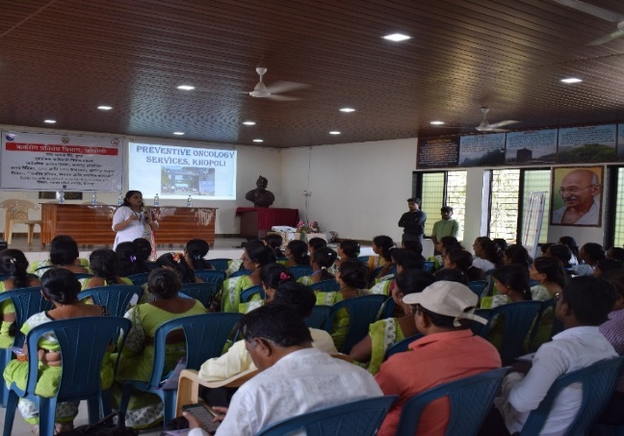
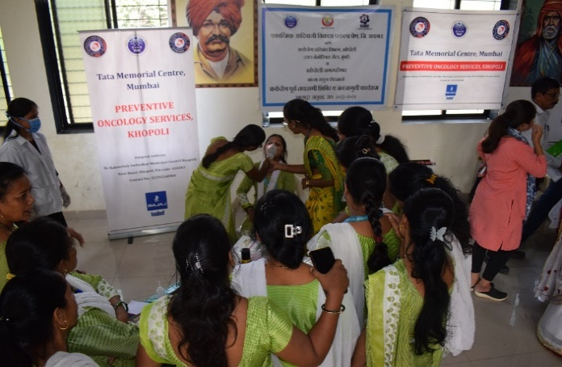
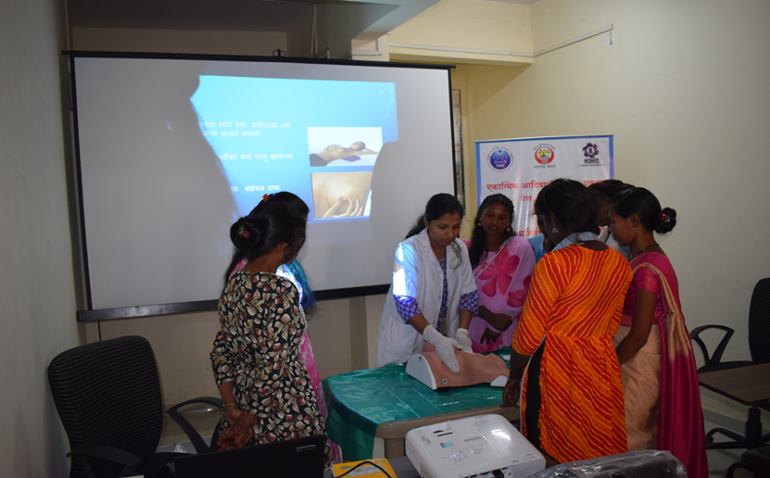
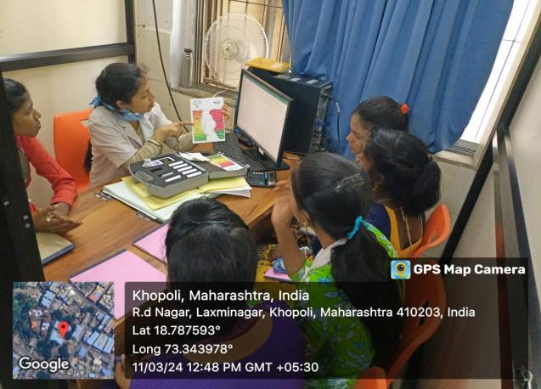
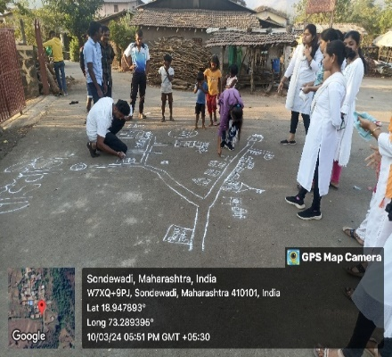
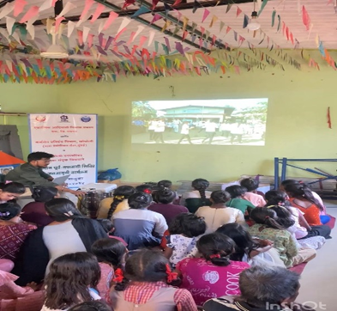
Training session for healthcare workers
10 days training workshop for tribal women
To equip healthcare workers with comprehensive understanding of cancer-related issues and cancer screening. 154 healthcare workers including 117 ASHAs, 13 ANMs, 13 MPWs, 3 LHVs and 8 CHOs trained in two single day workshops
Aimed to build a rapport, better understanding of socio-cultural beliefs and enable them to act as volunteers in screening activities. 20 Proactive women from tribal areas were identified with help of health workers and local leaders and trained through this workshop.
Awareness session for tribal youth
126 women aged between 15-30 years participated in workshops conducted across seven tribal villages. The sessions were made interesting using appropriate Participatory Rural Appraisal techniques and incorporating games.

Slide 6
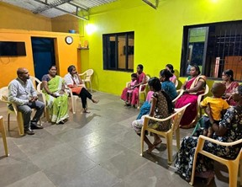
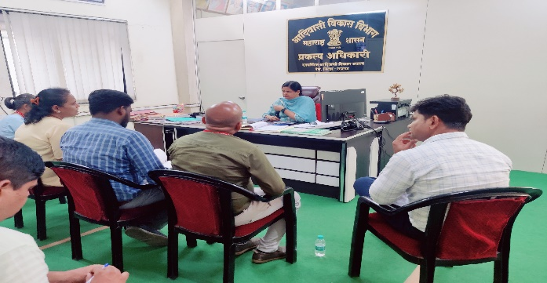
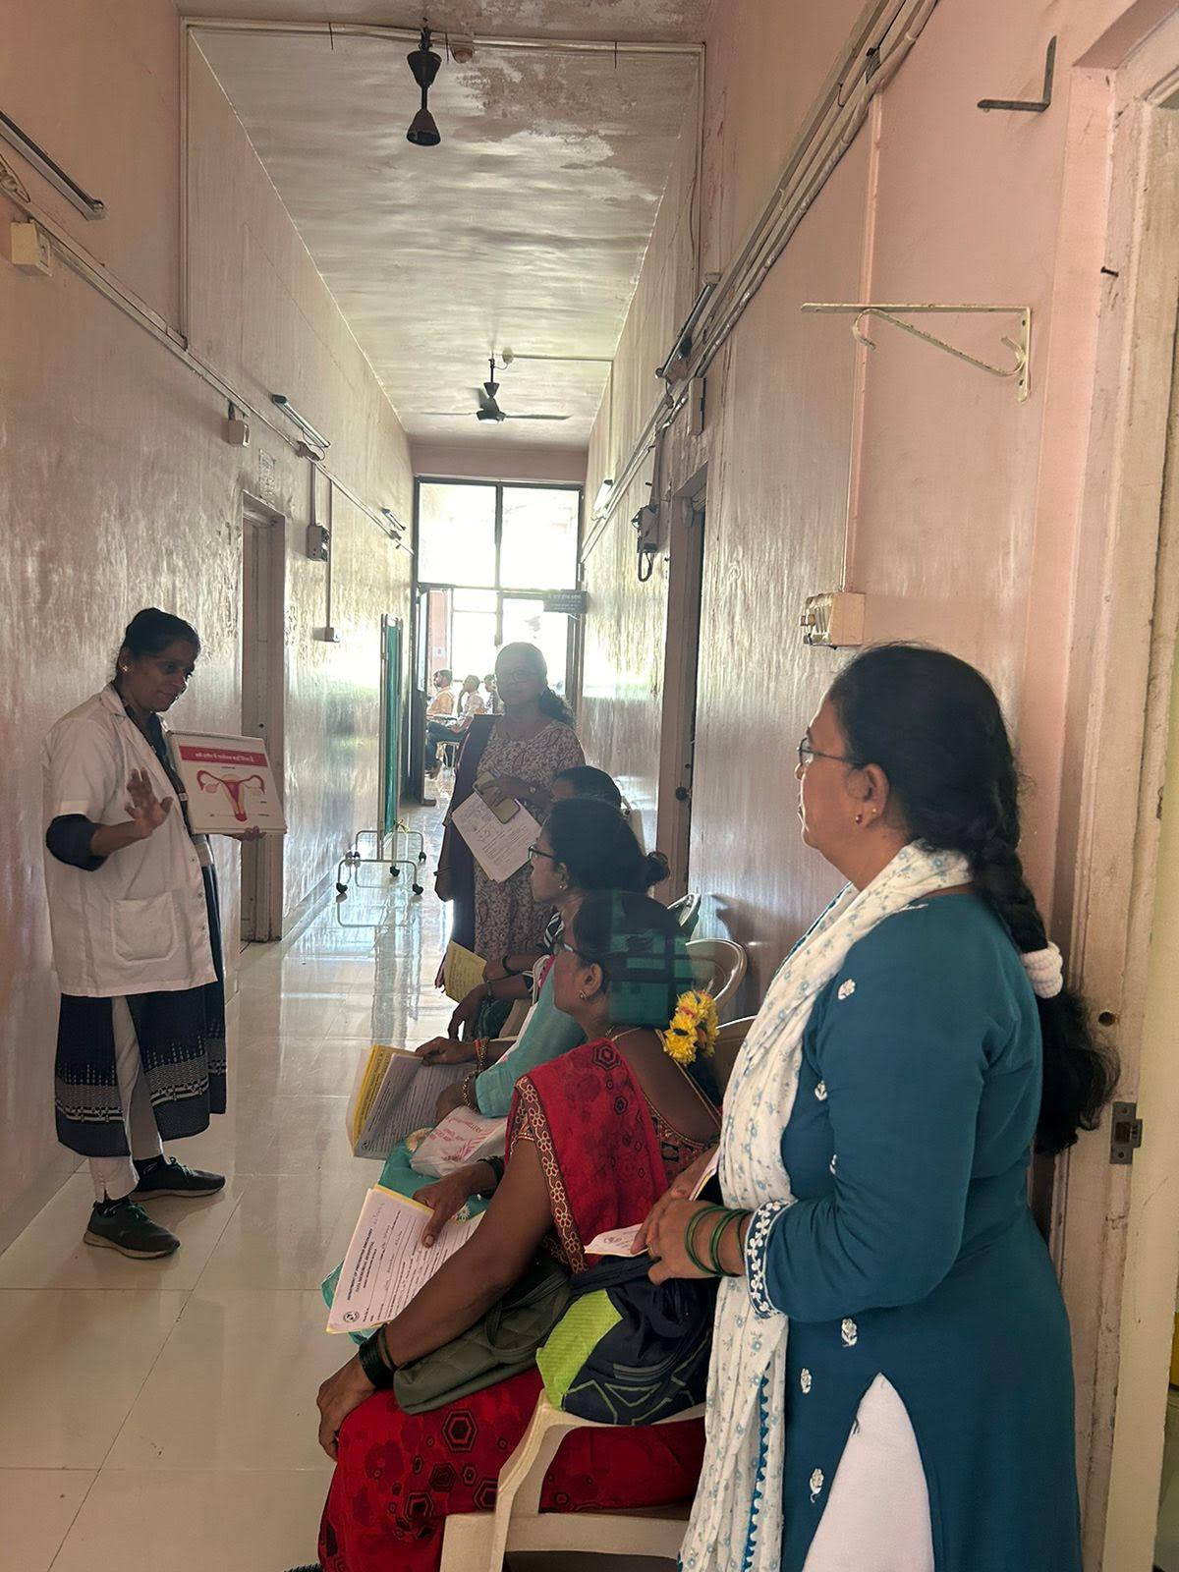
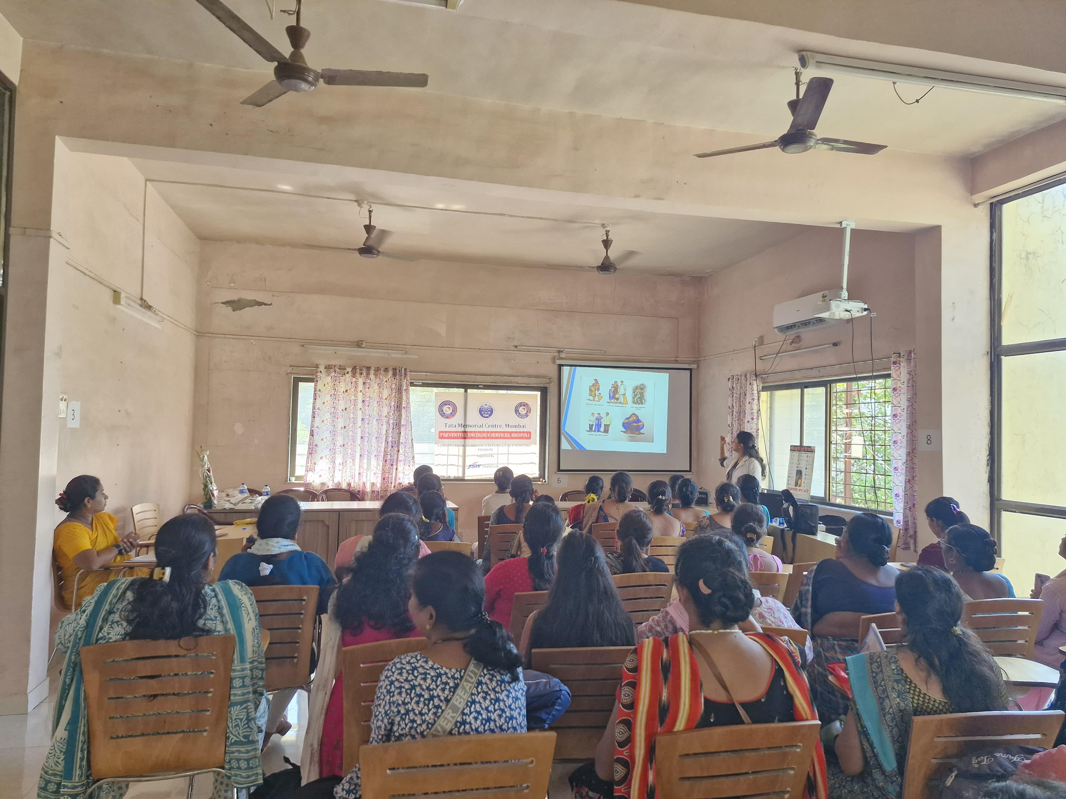
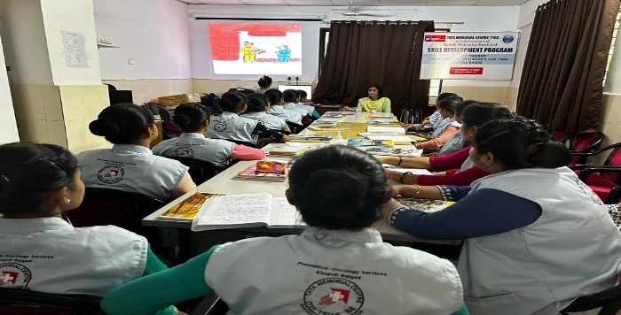
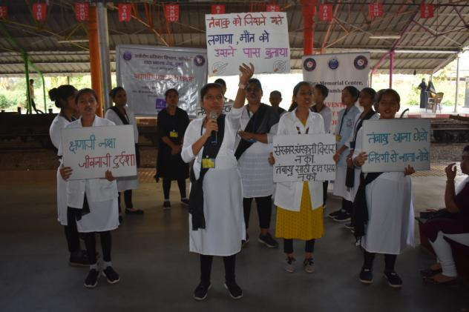
Stakeholder Meetings
Awareness session of CRPs
To enhance participation and effectiveness, clear communication and awareness sessions are conducted with all political and religious leaders prior to every community-based screening effort in the area.
Fifty community resource persons, who are key stakeholders in women self-help groups (SHGs) under the Maharashtra State Livelihood Mission, have been provided with cancer awareness training. The awareness and knowledge imparted to these resource persons have the potential to reach a broad network of women across the community.
Skill Development Program
A unique program aimed at training women from tribal villages of Khalapur tehsil with regards to cancer control, prevention and screening. Aims to move towards a comprehensive cancer control and prevention through community empowerment. One-year program including- observation in OPD, involvement in camps and field activities, theory lectures.
Other initiatives- Collaboration with public health system, Continuous community based awareness and advocacy campaigns

Slide 7
Community Engagement
System level
Capacity Building
Infrastructure
Program Sustainability
Problem Solving
Partnership
System level
Organizational development
Organizational level
Bottom Up Organisational Approach
Leadership
Individual level
Workforce development
Individual level
Fig 1: Framework for Capacity Building
Context

Slide 8
Table 1: Results and Discussion
 | N(%) | NFHS 5 (Maharashtra) | NFHS 4 | Kumar et.al, Tamil Nadu | McCowan et.al, Glasgow
Total women screened | 16,631 | 699,686 | 699,000 | 240 | -
Clinical breast examination (CBE) | 10,824 (65.1) | 0.9% | 10% | 35% | 72.6%
CBE Positive | 1,769 (16.3)
Visual Inspection with Acetic Acid (VIA) | 4915 (29.5) | 1.9% | 22% | 29% | 80.7%
VIA positive | 563 (11.5)
PAP/HPV done | 563 (100)
PAP/HPV positive | 29 (5.1)
Sociodemographic characteristics of the participants: Around 75% of the participants are below the age of 50years, 86% are Hindus, 89% are rural people, only 25% have college level education, 72% are unemployed, and 78% are married.

Slide 9
Strength
Holistic Approach
Weakness
Resistance to change
Threat
Cultural barriers
Opportunities
Policy advocacy
Sustainability
Lack of political will
Funding limitations
Better health outcomes
Leveraging technology
Community empowerment
Slow implementation
Resource intensive
Complex coordination
Multiple theories
Focus on rural settings
SWOT ANALYSIS

Slide 10
Conclusions
Capacity building can significantly enhance participation in cancer screening programs among women
This study underscores the importance of multi-faceted capacity-building strategies in addressing health disparities in vulnerable and high-risk populations
Focus should be on- developing comprehensive training programs, community engagement, fostering partnerships, ensuring sustainability, continuous monitoring and evaluation
This framework can act as a blueprint for future cancer control and prevention efforts in similar settings
References
Monica, Mishra R. An epidemiological study of cervical and breast screening in India: district-level analysis. BMC Women’s Health. 2020 Oct 7;20:225.
McCowan C, McSkimming P, Papworth R, Kotzur M, McConnachie A, Macdonald S, et al. Comparing uptake across breast, cervical and bowel screening at an individual level: a retrospective cohort study. Br J Cancer. 2019 Oct;121(8):710–4.
Learning from the Indian National Family Health Survey to assess population based oral, cervix and breast cancer screening in low-and-middle income countries - The Lancet Regional Health - Southeast Asia [Internet]. [cited 2024 Oct 22]. Available from: https://www.thelancet.com/journals/lansea/article/PIIS2772-3682(24)00133-1/fulltext
THANK YOU!!!!!!

